Slide 1

AERODYNAMICS OF FASE CAR – CFD PROJECT (WEEK 3) Flow reactions of the car GUIDED BY: PROF .DR. MEHMET SARIMURAT
-JAYAPRAKASH CHANDRAN 522242685

Slide 2

Graphical plots for coefficient of lift & drag and normal distribution for lift and drag

Slide 3
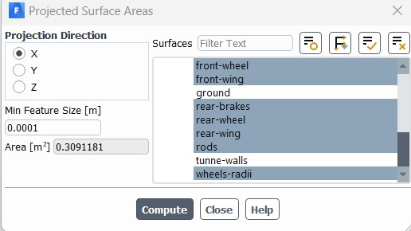
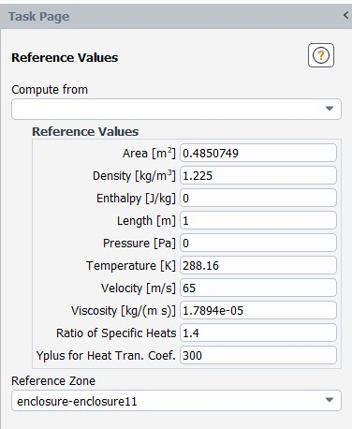
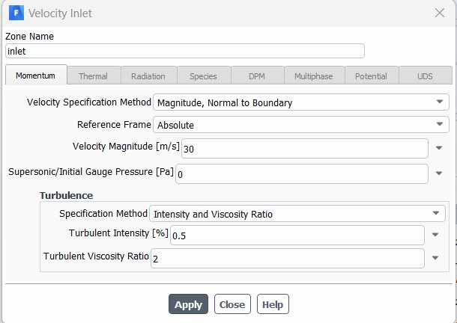
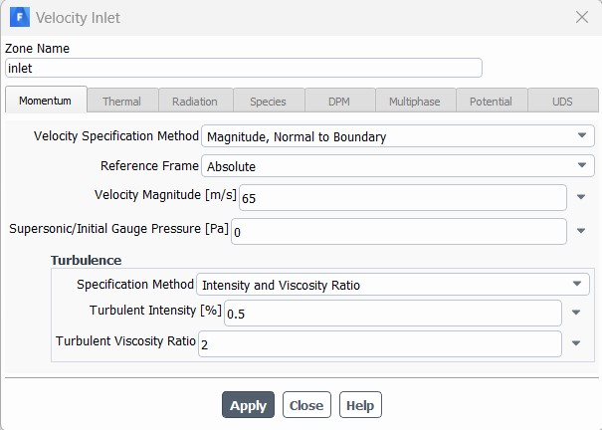
Flow analysis of the car at 30 m/s (68mph): Flow analysis of the car at 65m/s (146mph):
FIG. A1. Conditions for 30 m/s
FIG. A2. Conditions for 65 m/s

Slide 4
LIFT
Co – Efficient of lift
Lift is the aerodynamic force generated by an object, such as an aircraft wing, as it moves through a fluid medium, typically air.
It is perpendicular to the oncoming airflow and acts in an upward direction, opposing the force of gravity.
A lift is primarily responsible for supporting the object in flight or maintaining its balance during other forms of motion.
The coefficient of lift (Cl) is a dimensionless quantity that represents the lift generated by an object normalized by certain factors, such as the dynamic pressure, reference area, and other relevant parameters.
It is defined as the ratio of the lift force to the product of the dynamic pressure and the reference area.
The coefficient of lift provides a standardized measure that allows for the comparison of lift generation across different objects or conditions.

Slide 5
DRAG
Co – Efficient of Drag
Drag is the aerodynamic force experienced by an object moving through a fluid, typically air, in the direction opposite to its motion.
It acts parallel to the direction of the flow and opposes the object's motion through the fluid.
Drag is primarily caused by the interaction between the object's surface and the surrounding fluid, resulting in air resistance or fluid friction.
The coefficient of drag (Cd) is a dimensionless quantity that represents the drag experienced by an object normalized by certain factors, such as the dynamic pressure, reference area, and other relevant parameters.
It is defined as the ratio of the drag force to the product of the dynamic pressure and the reference area.
The coefficient of drag provides a standardized measure that allows for comparison of drag performance across different objects or conditions.

Slide 6
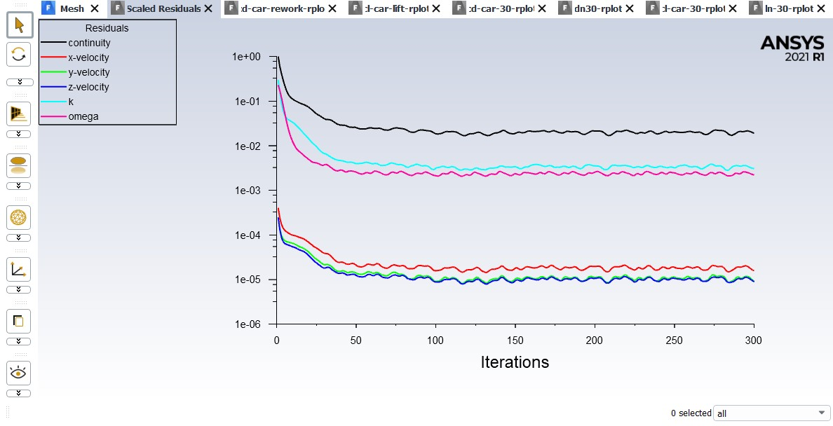
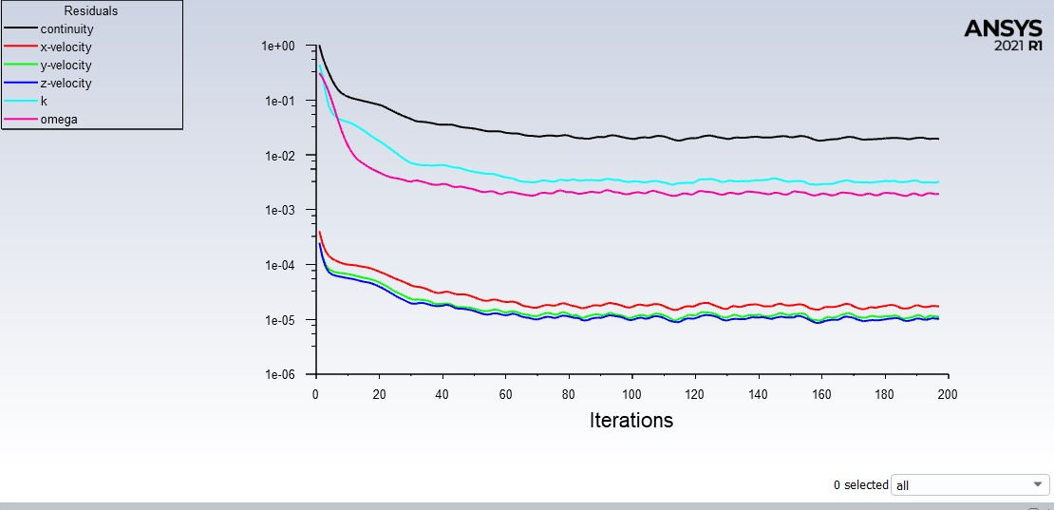
Scaled Residuals of the car at 30 m/s (68mph): Scaled Residuals of the car at 65 m/s (146mph):
FIG. A3. Scaled residuals for 30 m/s
FIG. A4. Scaled residuals for 65 m/s
Indeed, as we increase the velocity (m/s) in the CFD simulation, there can be a noticeable difference in the scaled residuals and the number of iterations required for convergence. This indicates that higher velocities have an impact on the convergence behavior of the simulation.
The slight difference in the fractions of scaled residuals and the graph of iterations clearly demonstrates that increasing the velocity introduces additional complexities to the flow field, which in turn affects the convergence rate.

Slide 7
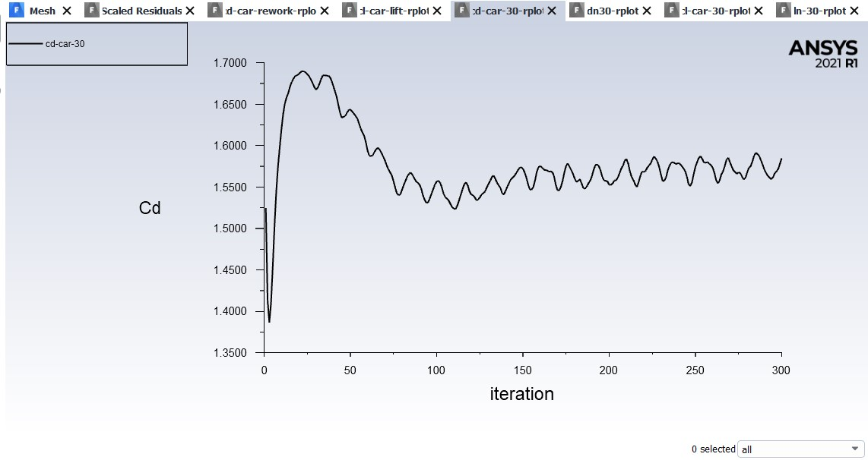
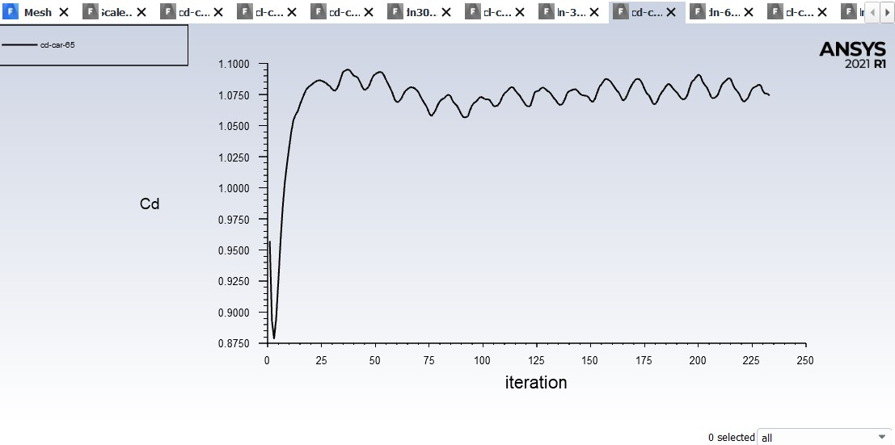
Coefficient of drag at 30 m/s (68mph): Coefficient of drag at 65 m/s (146mph):
FIG. A5. Cd at 30 m/s
FIG. A6. Cd at 65 m/s
In the case of the 30 m/s flow, the coefficient of drag (Cd) exhibits a decreasing trend up to a certain point. However, for the 65 m/s flow, the coefficient of drag does not show a significant decrease. This observation suggests that there is a fluctuation or instability in the drag forces experienced when the higher speed is reached.
The increase in velocity can introduce complex flow phenomena, such as separation, turbulence, or shock waves, which can lead to variations in drag behavior.
It indicates that the flow conditions at higher speeds are more challenging to predict accurately, and additional measures, such as refined numerical methods or turbulence modeling, may be required to capture these complexities and accurately estimate the drag forces.

Slide 8
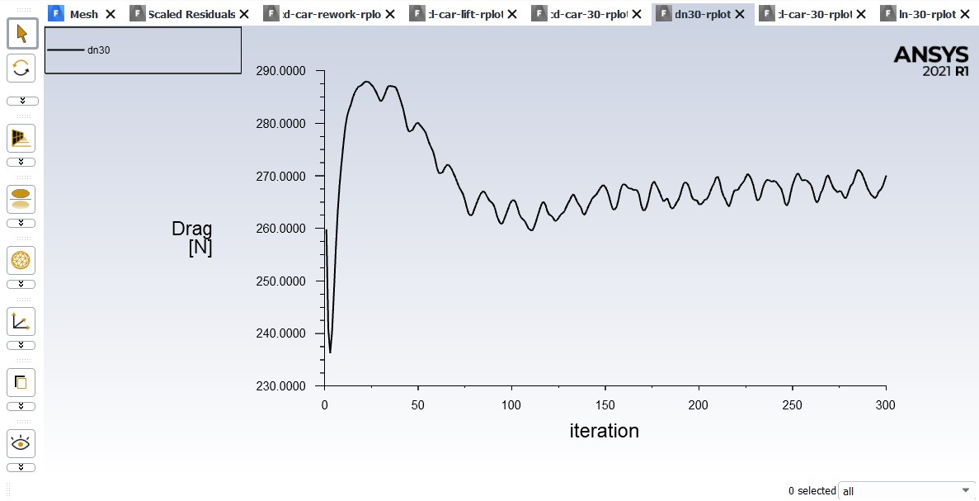
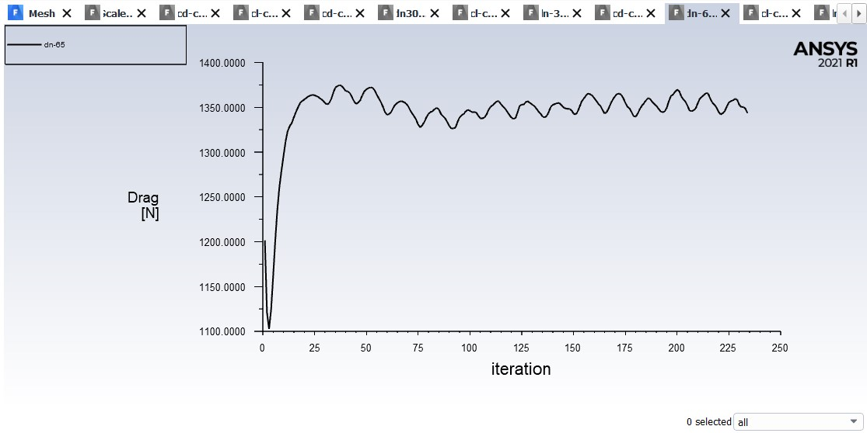
Normal Distribution of Drag at 30 m/s (68mph): Normal distribution of drag at 65 m/s (146mph):
FIG. A7. D[N] at 30 m/s
FIG. A9. D[N] at 65 m/s
The normal distribution of drag provides information about the statistical variation in drag forces, while the coefficient of drag at 30 m/s and 65 m/s represents the average drag behavior at those specific velocities.
The difference between these two lies in the level of detail and characterization of the drag forces.
The coefficient of drag provides a single value, while the normal distribution describes the probability distribution of drag values.

Slide 9
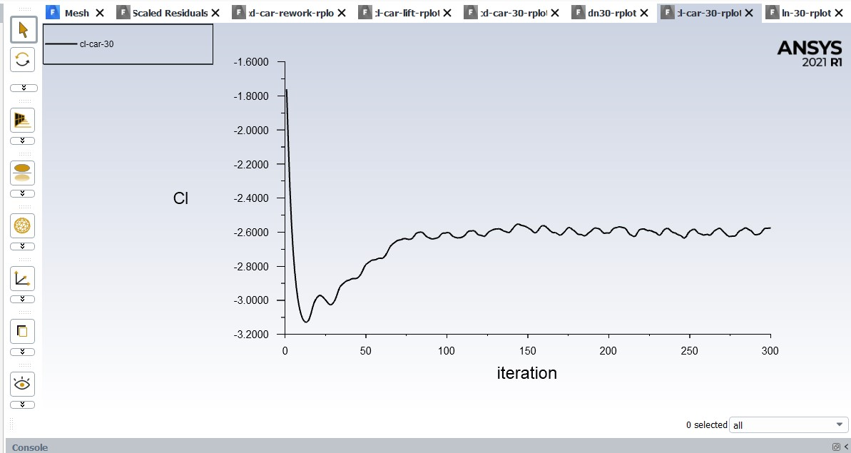
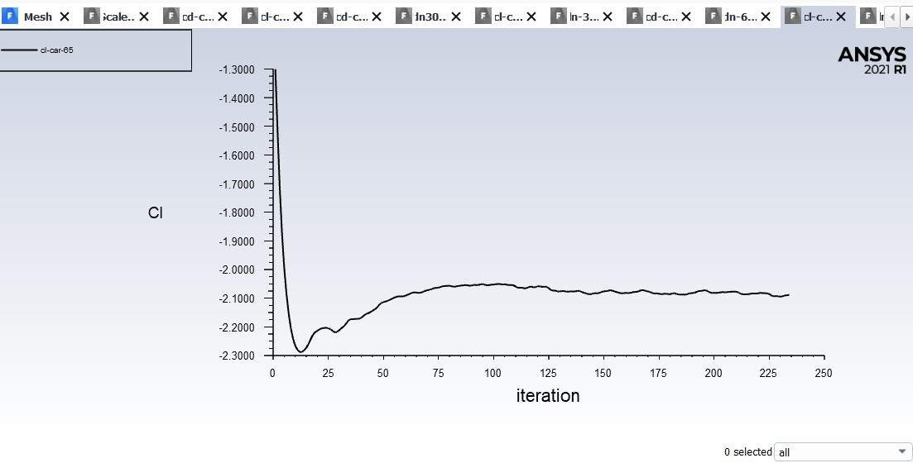
Coefficient of lift at 30 m/s (68mph): Coefficient of lift at 65 m/s (146mph):
FIG. A10. Cl at 30 m/s
FIG. A11. Cl at 65 m/s
At 30 m/s, Cl exhibits a slight gap between the value and the baseline, indicating there is still some downward force acting on the object or that the lift force is not strong enough to completely lift the object off the ground.
In contrast, at 65 m/s, Cl touches or even surpasses the baseline, indicating that the lift force generated by the object or airflow is experiencing a lift force that exceeds its weight, allowing it to rise higher velocity.
Higher velocities may result in increased airflow velocities, changes in flow separation patterns, and altered aerodynamic forces, all of which can affect lift generation and its interaction with the ground or surface on which the object rests.

Slide 10
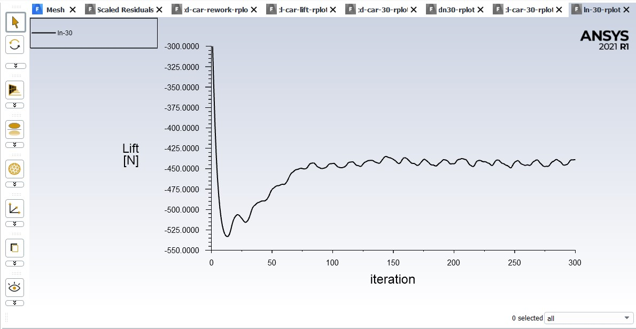
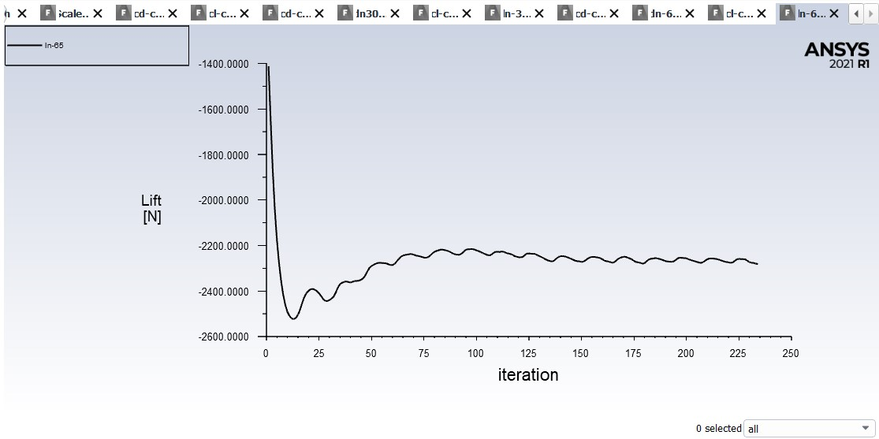
Normal Distribution of lift at 30 m/s (68mph): Normal distribution of lift at 65 m/s (146mph):
FIG. A12. L[N] at 30 m/s
FIG. A13. L[N] at 65 m/s
The normal distribution of lift provides information about the statistical variation in lift forces experienced by an object, while the coefficient of lift at 30 m/s and 65 m/s represents the average lift behavior at those specific velocities.
The distinction between the normal distribution and the coefficient of lift lies in the level of detail and characterization of the lift forces. The coefficient of lift provides a single value that represents the average lift force, while the normal distribution describes the probability distribution of lift values.
In summary, the normal distribution of lift captures the statistical variation in lift forces, while the coefficient of lift at specific velocities provides a simplified representation of the average lift behavior.

Slide 11
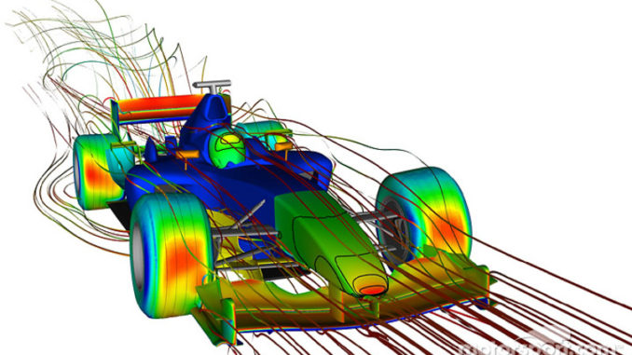

Post-processing Velocity & pressure contour

Slide 12
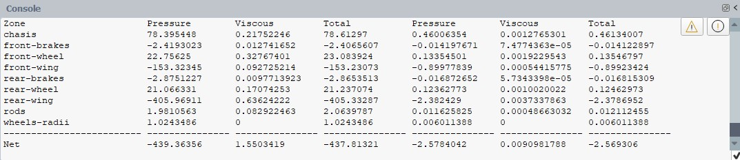
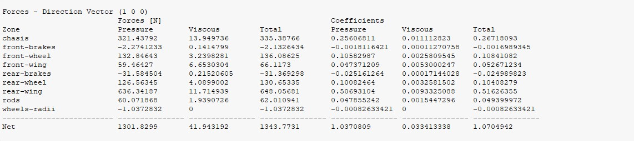
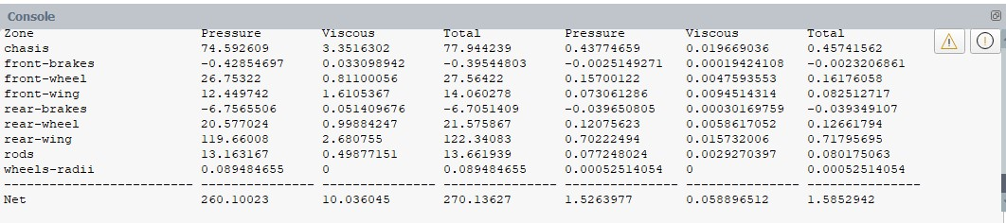
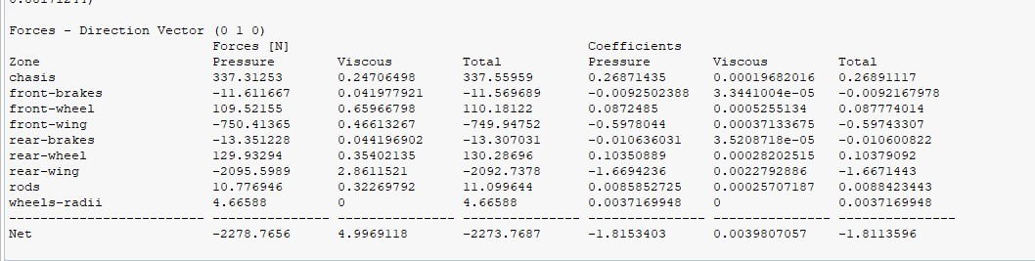
FORCE REPORT – 30 & 65 m/s
FIG. B1. Force Report of X dirt. for 30m/s
FIG. B3. Force Report of X dirt. for 65m/s
FIG. B2. Force Report of Y dirt. for 30m/s
FIG. B4. Force Report of Y dirt. for 65m/s

Slide 13
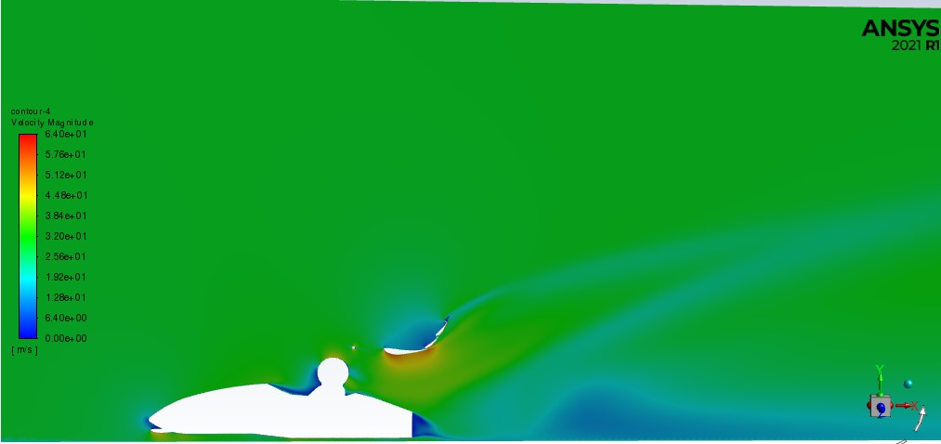
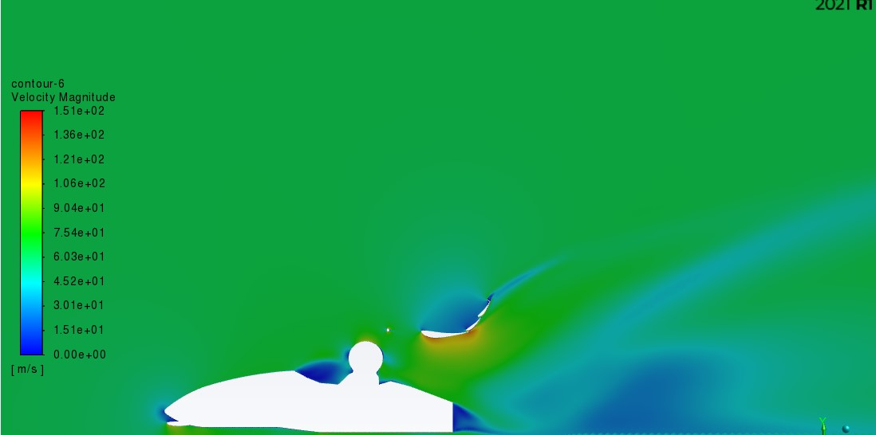
Velocity Contour 30 m/s (68mph): Velocity contour at 65 m/s (146mph):
FIG. B7. VC at 30 m/s
FIG. B8. VC at 65 m/s
At 30 m/s, the velocity flow slightly impacts the driver's head, indicating a moderate effect from the airflow. However, at 65 m/s, the velocity flow hits the driver's head more forcefully, suggesting a stronger impact from the airflow.
Additionally, as the flow passes over the car at 65 m/s, there is a high variation in the flow pattern. This variation indicates the presence of complex flow phenomena such as turbulent eddies, vortices, or flow separation, which can significantly influence the aerodynamic behavior of the car.
Higher velocities not only result in increased forces exerted on the driver but also introduce more intricate flow patterns, which can affect the overall aerodynamic performance and stability of the vehicle.

Slide 14
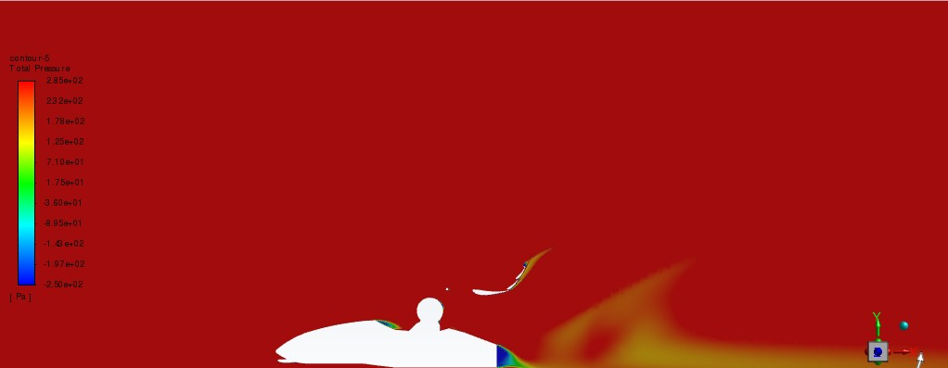
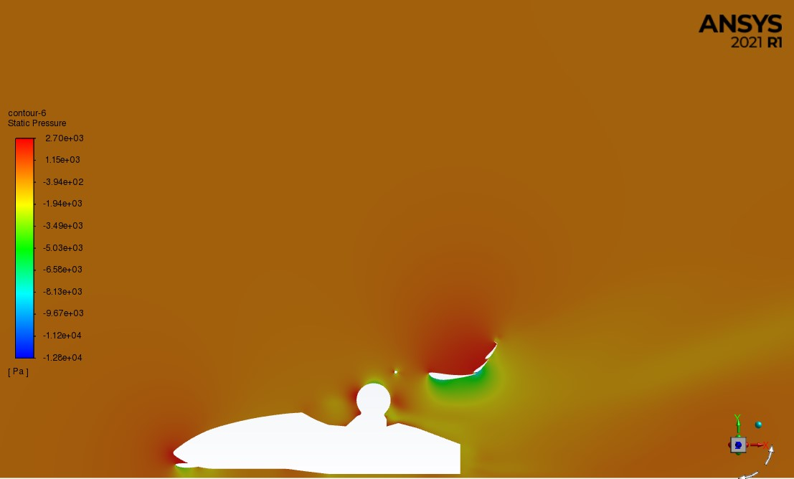
Pressure Contour 30 m/s (68mph): pressure contour at 65 m/s (146mph):
FIG. B5. PSI at 30 m/s
FIG. B6. PSI at 65 m/s
The pressure contours visually represent this relationship by depicting regions of higher and lower pressure throughout the flow domain. At 65 m/s, the pressure contours may exhibit higher psi values compared to the 30 m/s case, indicating an overall increase in pressure as a result of the higher velocity.
his trend is often associated with Bernoulli's principle, which states that an increase in the velocity of a fluid is accompanied by a decrease in pressure.

Slide 15
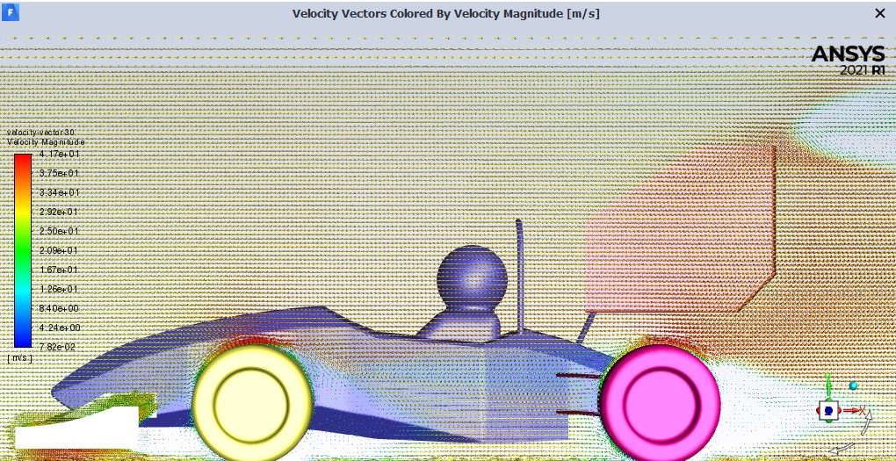
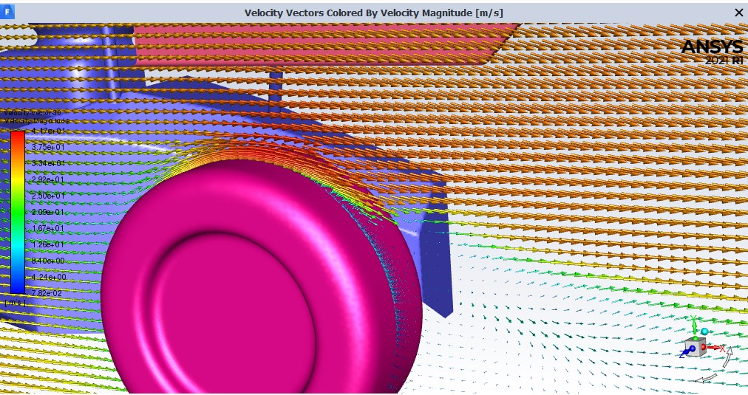
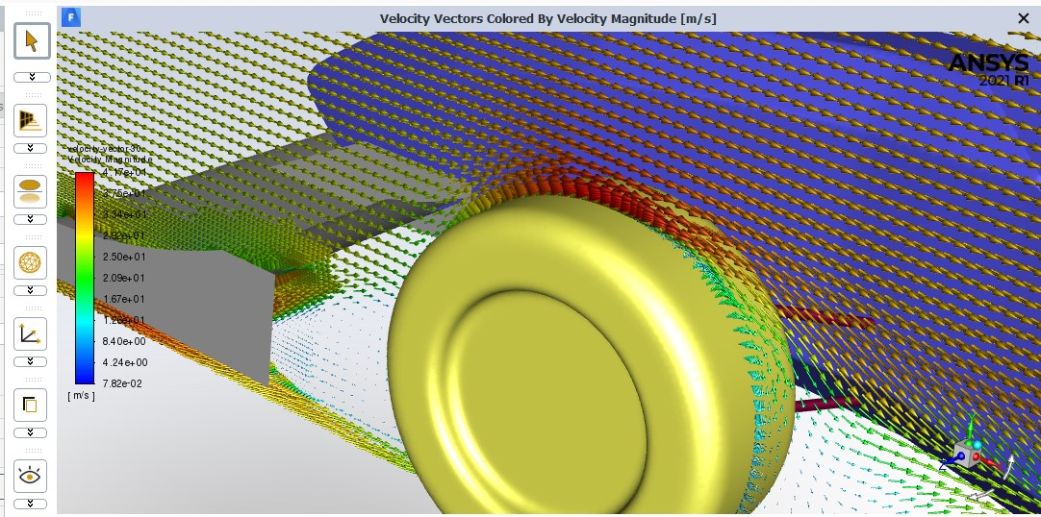
FLUID FLOW RXN AT 30M/S:
Figs. B9. 30 m/s

Slide 16
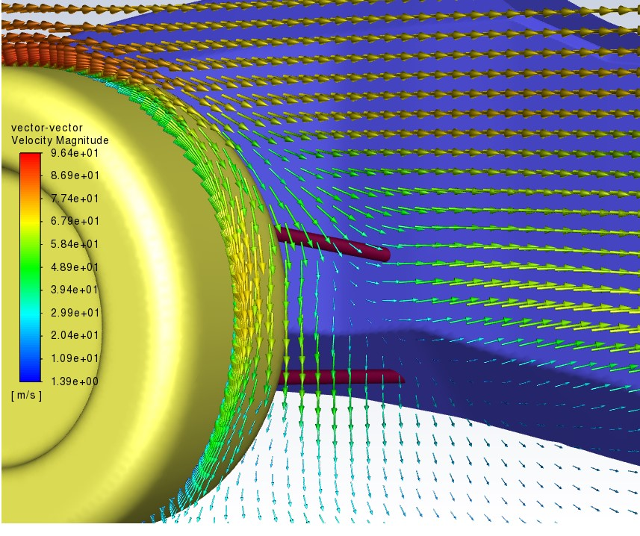
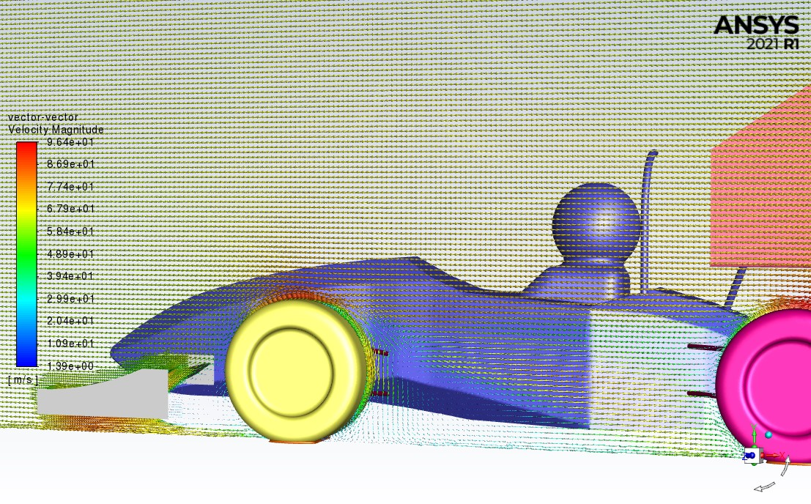
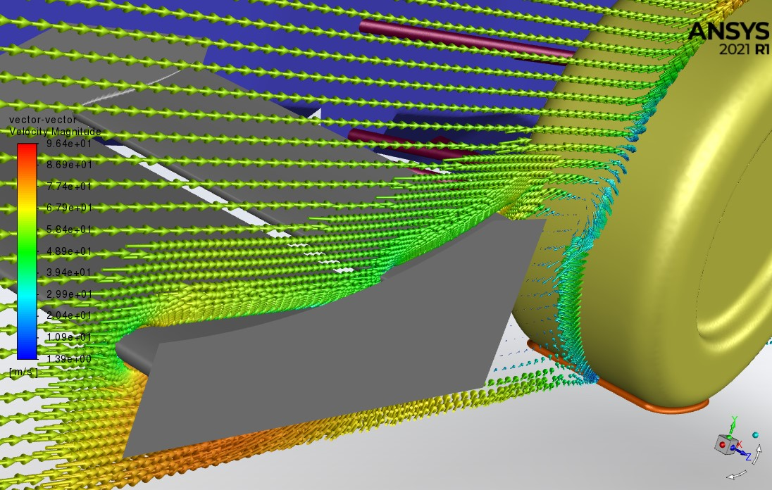
FLUID FLOW RXN AT 65 M/S:
Figs. B10. 30 m/s

Slide 17
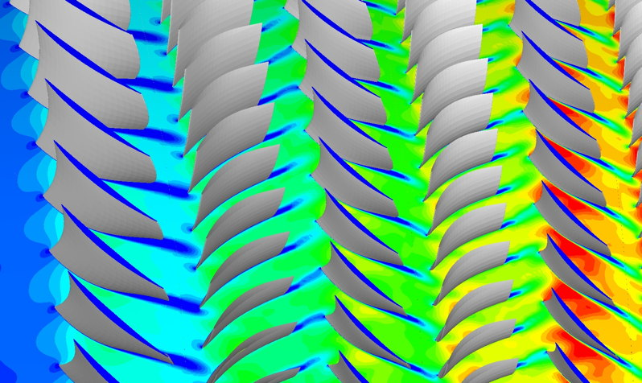
Post-processing path lines and re circulation region
This Photo by Unknown Author is licensed under CC BY-SA

Slide 18
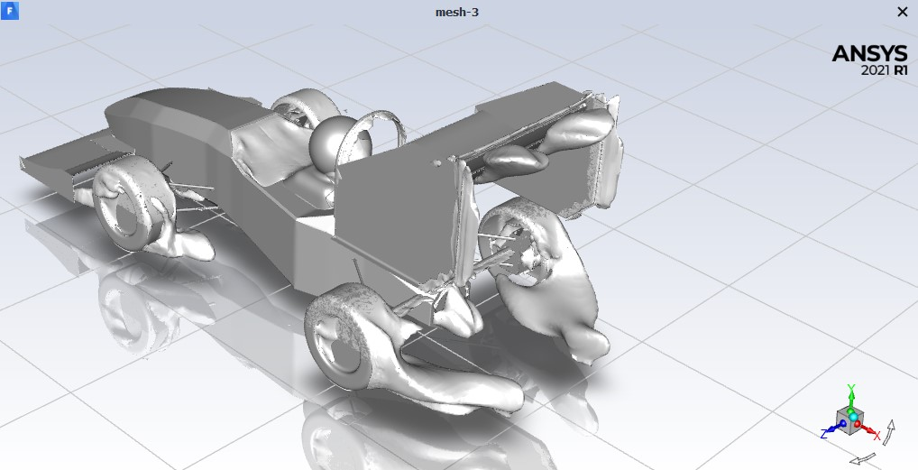
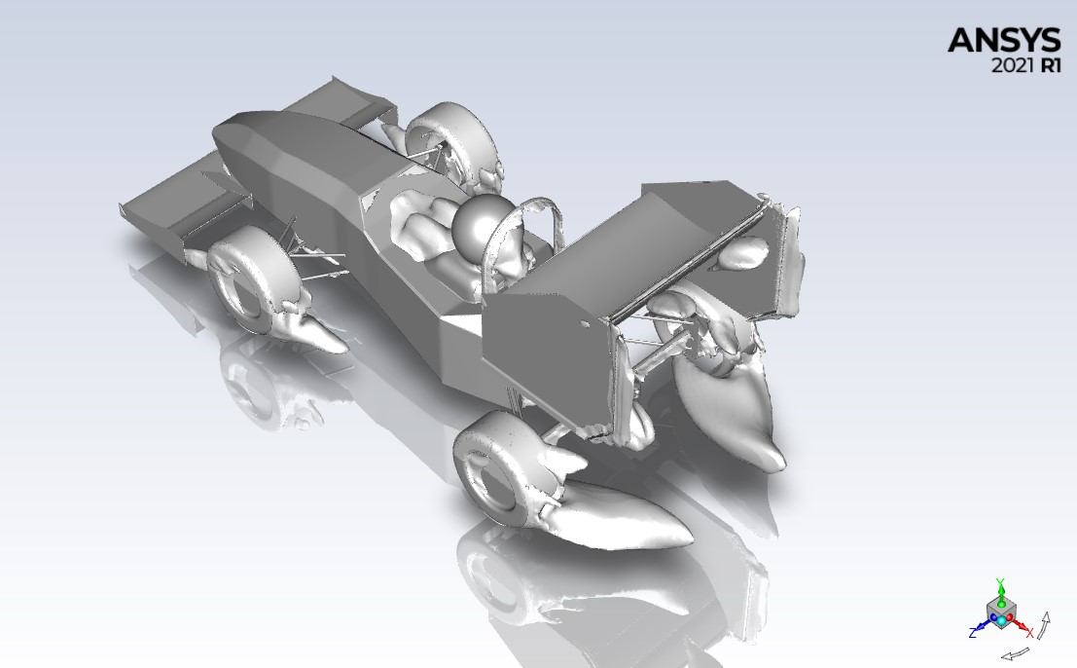
Re-circulation Region at 30 m/s (68mph): Re-circulation Region at 65 m/s (146mph):
FIG. C1 – Recirculation region 30m/s
FIG. C2 – Recirculation region 65m/s
The differences in the size and prominence of the recirculation regions between the two velocities are attributed to the increased flow momentum and dynamic forces at higher speeds. The higher velocity helps maintain attached flow along the wing surface, resulting in a reduced flow separation and a smaller recirculation region.
It's important to note that the specific shape and characteristics of the recirculation region can vary depending on the aerodynamic design, geometry, and flow conditions of the wing or object being analyzed.

Slide 19
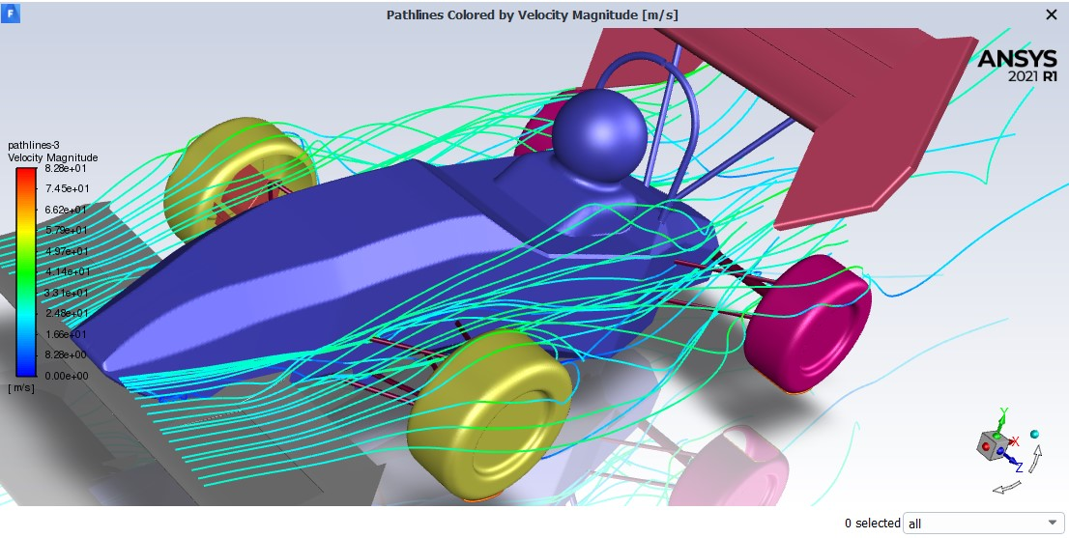
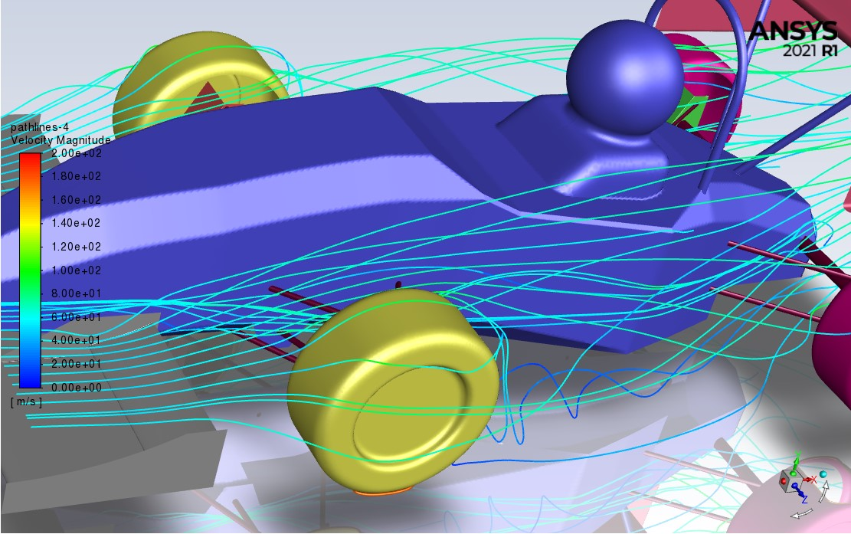
Path lines at 30 m/s (68mph): Path lines at 65 m/s (146mph):
FIG. C4 – path lines at 30 m/s
FIG. C4 – path lines at 65m/s
The path lines for both flows are generally similar, with a slight deviation occurring at a marked circle after the first wheel. This deviation indicates a change in the flow behavior or flow path at that particular location.
The specific cause of the deviation in the path lines, which can be inferred from the coefficient of lift (Cl) plot where it touches the baseline, is the presence of an aerodynamic phenomenon known as lift-off or lift-induced separation.
When the coefficient of lift reaches or touches the baseline, it indicates that the lift generated by the object or airflow is equal to or greater than the weight of the object. This phenomenon occurs when the flow over the object's surface reaches a critical angle of attack, resulting in increased lift production. As a consequence, the flow may separate from the surface, causing a deviation in the path lines.

Slide 20
SUMMARY:
At 30 m/s, the analysis revealed a significant flow deviation near the wing, leading to the formation of a bulging body. This suggests a localized region of recirculation. The pressure contours showed a slight increase in pressure in this area, indicating a build-up of flow resistance. Additionally, the path lines exhibited a minor deviation after passing the first wheel, indicating a slight disturbance in the flow pattern.
In contrast, at 65 m/s, the flow report observed a more pronounced deviation in the flow pattern. The formation of a larger bulge body near the wing indicated a stronger recirculation region. The pressure contours showed a significant increase in pressure in this area, suggesting higher flow resistance. Beyond the car, the flow exhibited high variations, indicating more complex flow dynamics.
The analysis of lift and coefficient of lift (Cl) revealed that at both velocities, there was an increase in lift compared to the baseline. However, at 65 m/s, the increase in lift was more pronounced, touching and raising above the baseline. This indicates a stronger aerodynamic lift force at higher velocities.
Regarding the drag and coefficient of drag (Cd), the report found that the drag force increased with increasing velocity. The coefficient of drag also showed a higher value at 65 m/s, indicating increased aerodynamic drag. This is consistent with the observation of higher flow resistance and pressure buildup at this velocity.
In conclusion, the flow report highlighted the differences in flow characteristics between 30 m/s and 65 m/s velocities. The higher velocity exhibited more pronounced deviations in flow patterns, stronger recirculation regions, and increased drag and lift forces. These findings provide valuable insights for understanding and optimizing the aerodynamic performance of the system at different operating speeds.

Slide 21
TO CALCULATE THE COEFFICIENT OF LIFT (CL) USING THE GIVEN VALUES, BY FORMULA:
Cl = (2 * Lift Force) / (Density * Velocity^2 * Area) Substituting the values provided: Lift Force = 141.1 lbf Density = 1.225 kg/m³ Velocity = 30 m/s Area = 0.3 m² First, let's convert the lift force from pounds-force (lbf) to Newtons (N): Lift Force = 141.1 lbf * 4.448 N/lbf ≈ 627.2548 N Now, we can calculate the coefficient of lift (Cl): Cl = (2 * 627.2548 N) / (1.225 kg/m³ * (30 m/s)^2 * 0.3 m²) Cl ≈ 1.449 Therefore, the coefficient of lift for 30 m/s (Cl) is approximately 1.449 Therefore, the coefficient of lift for 65 m/s (Cl) is approximately 2.640.

Slide 22
TO CALCULATE THE COEFFICIENT OF DRAG (CL) USING THE GIVEN VALUES, BY FORMULA:
Cd = (2 * Drag Force) / (Density * Velocity^2 * Area)
Substituting the values provided:
Drag Force = 264.6 N
Density = 1.225 kg/m³
Velocity = 30 m/s
Area = 0.3 m²
Now, let's calculate the coefficient of drag (Cd):
Cd = (2 * 264.6 N) / (1.225 kg/m³ * (30 m/s)^2 * 0.3 m²)
Cd ≈ 0.305
Therefore, the coefficient of drag for 30 m/s (Cd) is approximately 0.305. Therefore, the coefficient of drag for 65 m/s (Cd) is approximately 1.973

Slide 23
THANK YOU!

